Slide 1


THE PENTESTING HANDBOOK
A Comprehensive Guide to Securing Your Digital Assets
Sisserou Digital Solutions Ltd

Slide 2





WHAT IS PENETRATION TESTING?
Ethical Hacking & Security Assessment
Penetration testing, also known as ethical hacking, is a simulated cyberattack against your computer system to check for exploitable vulnerabilities. It serves as a critical component of a robust cybersecurity strategy.
Proactive Defense:
Identify weaknesses before malicious actors do.
Risk Understanding:
Assess the potential impact of security flaws.
Actionable Insights:
Receive concrete recommendations for remediation.
Sisserou Digital Solutions Ltd

Slide 3






THE PENTESTING LIFECYCLE
A structured methodology ensuring a comprehensive and systematic approach to security assessment.
PHASE 01
PHASE 02
PHASE 03
PHASE 04
PHASE 05
Reconnaissance
Scanning
Vulnerability Assessment
Exploitation
Reporting
Gathering initial intelligence on the target via passive and active means.
Identifying open ports, services, and potential entry points.
Analyzing and prioritizing identified weaknesses and flaws.
Attempting to gain access to systems by exploiting vulnerabilities.
Documenting findings, impact, and remediation steps.
Sisserou Digital Solutions Ltd

Slide 4






PHASE 1: INFORMATION GATHERING
The Foundation of a Successful Pentest
Passive Reconnaissance
Active Reconnaissance
Collecting information from publicly available sources without directly interacting with the target's systems.
Direct interaction with the target's systems to gather specific technical information.
OSINT: Open-Source Intelligence gathering.
>
System Interaction: Probing for live hosts and open ports.
>
Public Records: Analyzing websites, social media, and news.
>
Network Mapping: Identifying network topology.
>
No Trace: Ideally leaves no digital footprint on target logs.
>
Risk: Higher chance of detection by IDS/IPS.
>
ESSENTIAL TOOLS
Whois
NSlookup
Maltego
Shodan
Sisserou Digital Solutions Ltd

Slide 5







PHASE 2: SCANNING
Uncovering Attack Vectors through Network and Vulnerability Analysis
PORT SCANNING
NETWORK MAPPING
VULNERABILITY SCANNING
Determining which ports are open and listening for connections. This identifies potential entry points into the system and reveals running services.
Creating a visual representation of the target's network infrastructure. This helps in understanding the topology and relationships between devices.
Using automated tools to identify known vulnerabilities in systems and applications. This provides a baseline of security flaws to investigate further.
KEY TOOLS
Nmap (Network Mapper)
Nessus
OpenVAS
Sisserou Digital Solutions Ltd

Slide 6


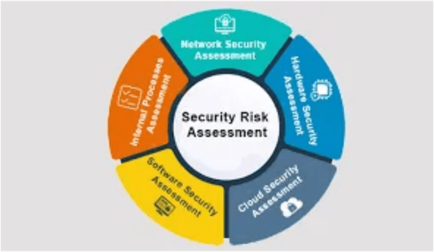


PHASE 3: VULNERABILITY ASSESSMENT
From Raw Data to Actionable Insights
Analyzing Scan Results
RISK_ASSESSMENT_MODULE
Reviewing output from automated scanners to identify potential security weaknesses. Not all findings are valid; expert analysis is required to interpret the data correctly.
Prioritizing Vulnerabilities
Using the Common Vulnerability Scoring System (CVSS) to assign severity scores (0.0 - 10.0). This helps organizations focus on the most critical risks first.
CVSS SEVERITY SCALE
Validating Findings
LOW
MED
HIGH
CRIT
Differentiating between False Positives (erroneous alerts) and true vulnerabilities to ensure the final report is accurate and actionable.
0.0 ────────────── 10.0
Sisserou Digital Solutions Ltd

Slide 7








PHASE 4: EXPLOITATION
The Moment of Truth: Gaining Access and Demonstrating Impact
Gaining Access
Post-Exploitation
Controlled Exploitation
Privilege Escalation
Safely exploiting identified vulnerabilities to verify their existence without causing damage.
Moving from a standard user account to administrator or root access.
Metasploit Framework
Lateral Movement
Utilizing industry-standard tools to execute payloads and manage sessions.
Pivoting through the network to access other systems and sensitive data repositories.
Social Engineering
Impact Demonstration
Manipulating human factors to bypass technical controls when necessary.
Proving the potential business impact through data access or system control.
Sisserou Digital Solutions Ltd

Slide 8

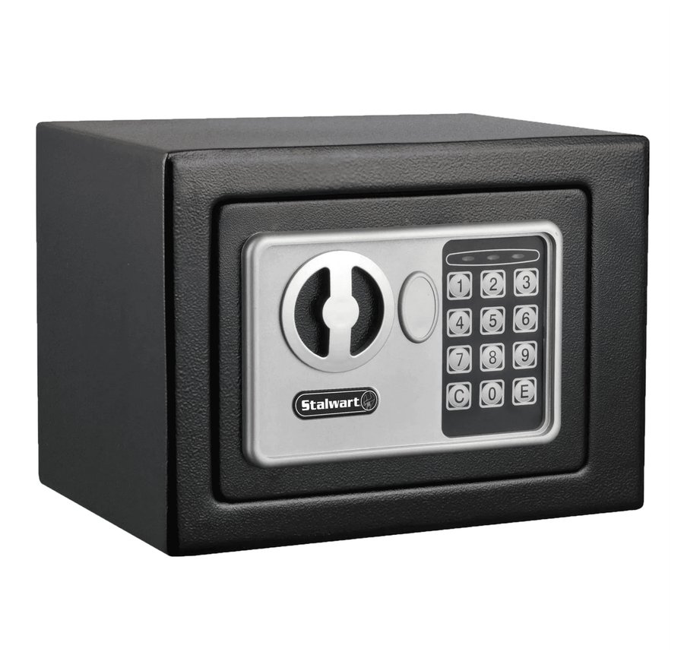



PHASE 5: REPORTING
Communicating Findings & Actionable Insights
The report is the most critical deliverable of a penetration test. It translates technical findings into business risks and actionable remediation steps.
Executive Summary
High-level overview of risks and business impact for non-technical stakeholders.
Technical Details
In-depth analysis of vulnerabilities, proof of concepts, and reproduction steps for engineers.
Remediation Recommendations
Clear, practical steps to patch vulnerabilities and improve security posture.
Sisserou Digital Solutions Ltd

Slide 9




PENTESTING METHODOLOGIES
Structured Frameworks for Comprehensive Security Assessment
OSSTMM
OWASP
NIST SP 800-115
Open Source Security Testing Methodology Manual
Open Web Application Security Project
Technical Guide to Information Security Testing
The de facto standard for web application security. The OWASP Testing Guide provides a comprehensive framework for identifying vulnerabilities in web apps, famous for its "Top 10" risks.
A peer-reviewed methodology for security testing that focuses on operational security. It provides a scientific approach to testing, emphasizing metrics and accurate characterization of security controls.
A standard developed by the National Institute of Standards and Technology. It provides guidelines for planning, conducting, and documenting penetration tests, widely used in government and regulated industries.
Sisserou Digital Solutions Ltd

Slide 10


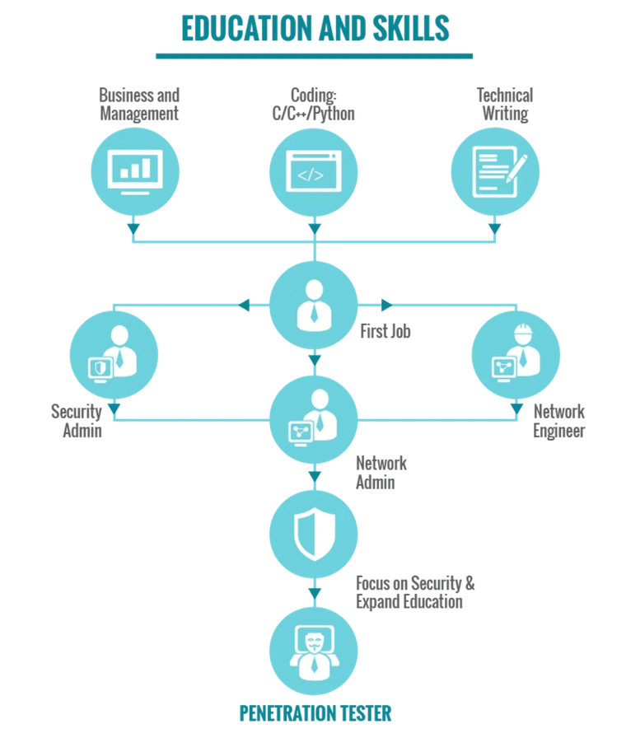





TYPES OF PENETRATION TESTING
Tailoring the Assessment to Your Specific Needs
By Knowledge Level
Black Box:
No prior knowledge
White Box:
Full knowledge
Grey Box:
Partial knowledge
By Perspective
External:
Simulating outside attacker
Internal:
Simulating insider threat
By Target Environment
Web Apps
Network
Mobile
Cloud
Sisserou Digital Solutions Ltd

Slide 11







LEGAL AND ETHICAL CONSIDERATIONS
Rules of Engagement & Professional Responsibility
LEGAL FRAMEWORK
ETHICAL RESPONSIBILITY
Authorization
Data Privacy
Written permission is mandatory before any testing begins. This "Get Out of Jail Free" card protects the tester from criminal liability under computer misuse laws.
Testers often encounter sensitive data (PII, financial records). Maintaining strict confidentiality and integrity of this data is paramount.
Scope of Work
Do No Harm
Clearly defining specific targets (IPs, domains, applications) and explicitly stating what is out of scope to prevent unintended legal consequences.
Avoiding actions that could disrupt business operations, such as Denial of Service (DoS) attacks, unless explicitly authorized and scheduled.
Sisserou Digital Solutions Ltd

Slide 12




CONCLUSION & KEY TAKEAWAYS
Building a More Secure Future
STRUCTURED LIFECYCLE
CONTINUOUS PROCESS
PROACTIVE DEFENSE
Security is not a one-time event. Regular testing is essential to adapt to new threats, evolving technologies, and changing environments.
Identifying and fixing vulnerabilities before they are exploited is the most cost-effective way to protect your reputation and digital assets.
Adhering to the five phases—Reconnaissance to Reporting—ensures a comprehensive and systematic assessment, leaving no stone unturned.
Sisserou Digital Solutions Ltd

Slide 13






ABOUT SISSEROU DIGITAL SOLUTIONS LTD
Your Trusted Partner in Cybersecurity Excellence
Who We Are
Sisserou Digital Solutions Ltd is a premier provider of cybersecurity services, dedicated to safeguarding organizations against the evolving landscape of digital threats. We combine technical expertise with strategic insight to deliver robust security solutions.
GET IN TOUCH
www.sisserou-digital.com
Our Commitment
contact@sisserou-digital.com
Our team of certified security professionals brings deep industry knowledge and a proactive approach to every engagement. We are committed to excellence, ensuring that your digital assets remain secure, compliant, and resilient.
+1 (555) 123-4567
Tech Park, Cyber City
Sisserou Digital Solutions Ltd

Slide 14


QUESTIONS & ANSWERS
Thank you for your attention.
We are now open for discussion.
Sisserou Digital Solutions Ltd

